Slide 1

Electronic Order Submission (EOS) System
Requirement and Software Mock-up

Slide 2

Scope for the Software
Build a web based workflow system for Hybrid customers to submit material pickup details in a weekly or monthly format and such request is then routed automatically to the Suppliers for acknowledgement while the Master Record by the Customer is moved through stage gates of action with necessary alerts and reports.
See following slides for this defined workflow

Slide 3
Roles for the Software
Role | Description | Action
Hybrid Admin | A person responsible for creating a new account for customer, partner or Hy-Brid user | Full Rights to Add/Modify/Delete accounts, See consolidated schedules, Historical, Run Reports
Customer | A customer with an established relationship and user id can submit pick-up order or modify supplier details | Controlled Rights – change password, create/modify pick up orders within a defined timeline, run historical and scheduled reports on the pickup status, receives confirmation on pick-up
Supplier Partner | Supplier Partner with active user id and password | Controlled Rights – change password, See submitted orders (their orders only), Run scheduled and historical reports
Common Features: Email alerts on submission, order received, order completed, password change.
Optional: Copies of any query report to Hybrid Management

Slide 4
Software Features
Internet based login via Hybrid website
Form submission by customer as auto insert (either completed by customer or by Hybrid employee)
Confirmation of order submission to customer
When saved of customer order – Auto alert to Suppliers with acknowledgement of the order for pick-up
Adjustable Dashboard View for Hybrid team to see status
Historical and Scheduled Reports – On-demand or Scheduled
Audit history (Login Trace, Login Exemptions, Reports and Queries, Password changes)

Slide 5
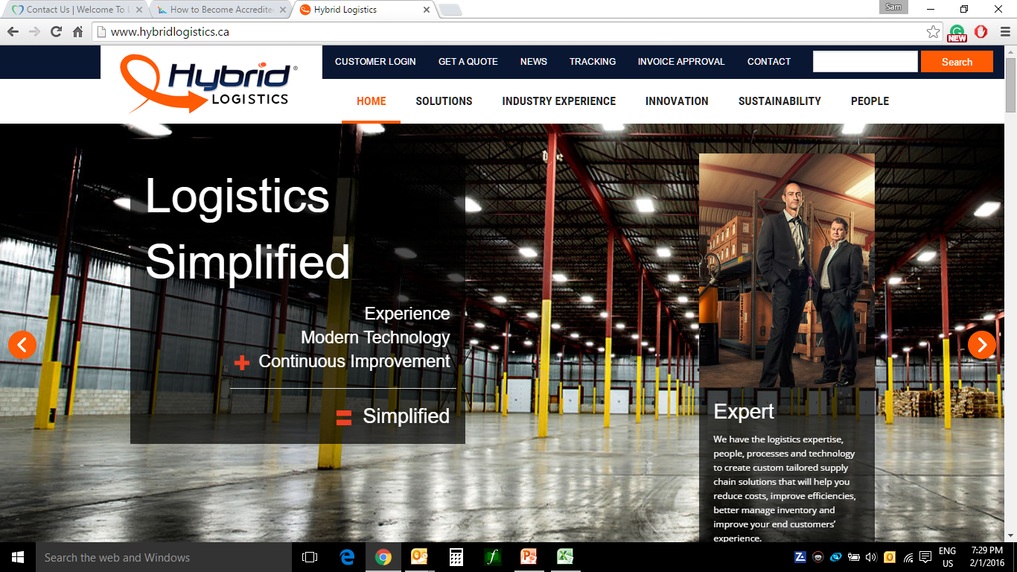
Screen Mock-up – Login Entry
LOGIN
Note: Hybrid to change Customer Login to LOGIN

Slide 6
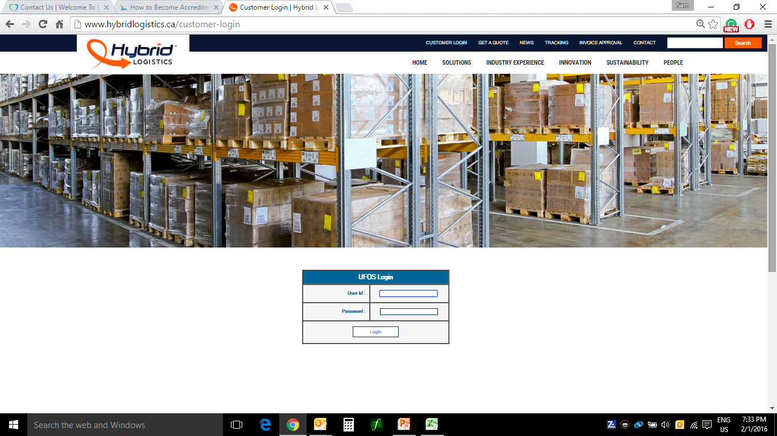
Screen Mock-up – EOS Login Page
EOS Login
Note: It is possible to have the EOS Login at the home page

Slide 7
Screen Mock-up – EOS Hybrid User
Welcome to Hybrid EOS System
User: Ali Sheikh, Hybrid
Last Login: Feb 1, 2016 09:45
Account Maintenance
Once the Supplier accepted with the delivery details, the system will hyper link the supplier to show the following details:
Total Skid Count: Dimensions: Freight Class: stackable?: Gross weight
SEE SUPPLIER ACCEPTANCE SLIDE FOR DETAILS
Scheduled Events – Week 1/11/2016 (Generated 1/8/2016 11:48)
Supplier - Canada | Plant | Pick-Up | Pick Up Day | Arrival Day | Stack | Comments | Supplier Status | Assigned to | Date | By | Status (Select)
Co-Ex-Tec to H&L | Newmarket | Yes | Tues | Thurs | Yes | 02/10/16 10:00 SHEIKHA: Found issues with qty 02/10/16 13:15 SZENTEC: Problem corrected | ACCEPTED
Etbo Tool & Die | Newmarket | Yes | Tues | Wed | Yes | -- | PENDING
Vision Coaters Canada | Newmarket | Yes | Daily | Daily | Yes | -- | PENDING
Aim Metals And Alloys Inc | Newmarket | No | Tues | Wed | Yes |  | PENDING
Dynacast | Bradford | No | Wed | Thurs | Yes | -- | PENDING
Dynacast | Newmarket | No | Wed | Thurs | Yes | -- | PENDING
PAPP Plastics | Newmarket | No | Fri | Mon | Yes | -- | PENDING
Precimold Inc | Newmarket | No | Tues | Wed | Yes | -- | PENDING
Synthane-Taylor | Bradford | No | Tues | Wed | Yes | -- | PENDING
Canada (Selected) | US | Mexico | Query | Save (when modified)
Note: The above you see in Blue column from the customer and the Orange column is Hybrid activities. Any Hybrid change requires ‘Save’. For ‘Query’ and ‘Account Maintenance’ – see separate slides

Slide 8

Screen Mock-up – EOS Hybrid User
Welcome to Hybrid EOS System
User: Ali Sheikh, Hybrid
Last Login: Feb 1, 2016 09:45
Account Maintenance
Account Maintenance
Manage User
New User
Update User
User Password
User Delete
Manage Partner
New Partner
Update Partner
Partner Password
Partner Delete
Canada | US | Mexico | Query | Current

Slide 9
Screen Mock-up – EOS Hybrid User
Welcome to Hybrid EOS System
User: Ali Sheikh, Hybrid
Last Login: Feb 1, 2016 09:45
Account Maintenance
Account Maintenance – Manage User
Details |  | Comments
User ID |  | Last Name/First Initial (e.g. SHEIKHA)
Full Name
Company | SELECT COMPANY FROM DROP DOWN | You need a Customer or Supplier in the system to create a USERID. If new customer or supplier enter details as such
Email Address |  | This is the email be used for password reset/order confirmation etc.
Password |  | 12 characters – 1 Cap, 1 Numeric, 1 Special Character – NO PREVIOUS PASSWORDS
 | DELETE | SAVE |  | HOME
For USERID password reset, you will simply enter the person’s USERID and reset password. When a password is reset, an email will be sent to user with the new password. To update user details such as email address – same screen. To DELETE a user, simply enter USERID and once the USERID is confirmed, click DELETE.

Slide 10
Screen Mock-up – EOS Hybrid User
Welcome to Hybrid EOS System User: Ali Sheikh, Hybrid
Last Login: Feb 1, 2016 09:45
Account Maintenance
Account Maintenance – Manage Partner
Details |  | Comments
Select Supplier Company
Contact Full Name
Select USERID or IDs |  | Last Name/First Initial (e.g. SHEIKHA)
Contact Phone No |  | Contact Phone No
Email Address |  | This is the email be used for password reset/order confirmation etc.
Password |  | 12 characters – 1 Cap, 1 Numeric, 1 Special Character – NO PREVIOUS PASSWORDS
Alternate Contact |  | Enter secondary contact and phone number
 | DELETE | SAVE |  | HOME
For Contact USERID password reset, you will simply enter the Contact USERID and reset password. When a password is reset, an email will be sent to user with the new password. To update user details such as email address – same screen. To DELETE a user, simply enter USERID and once the USERID is confirmed, click DELETE.

Slide 11
Screen Mock-up – EOS Hybrid User
Welcome to Hybrid EOS System
User: Cristina Szente, Magna
Last Login: Jan 31, 2016 09:45
Import Schedule
Scheduled Events – Week 1/11/2016 (Generated 1/8/2016 11:48)
Supplier – Canada | Plant | Pick-Up | Pick Up Day | Arrival Day | Stack | Comments | Supplier Status | Assigned to | Date | By | Status (Select)
Co-Ex-Tec to H&L | Newmarket | Yes | Tues | Thurs | Yes | --
Etbo Tool & Die | Newmarket | Yes | Tues | Wed | Yes | --
Vision Coaters Canada | Newmarket | Yes | Daily | Daily | Yes | --
Aim Metals And Alloys Inc | Newmarket | No | Tues | Wed | Yes | --
Dynacast | Bradford | No | Wed | Thurs | Yes | --
Dynacast | Newmarket | No | Wed | Thurs | Yes | --
PAPP Plastics | Newmarket | No | Fri | Mon | Yes | --
Precimold Inc | Newmarket | No | Tues | Wed | Yes | --
Synthane-Taylor | Bradford | No | Tues | Wed | Yes | --
Canada (Selected) | US | Mexico | Query | Save (when modified)
Note: The above you see in Blue column from the customer and the Orange column is Hybrid activities. Any changes to the submission will require a save. Once the customer SAVEs then the account will be locked for them. Only Hybrid can make changes to any client SAVEed submission.

Slide 12
Screen Mock-up – EOS Hybrid User
Welcome to Hybrid EOS System
User: Cristina Szente, Magna
Last Login: Jan 31, 2016 09:45
Important Scheduled
Description | Action
File Name (File stored within the EOS for verification) | Select
Submitted By – Auto user name | Christina Szente
Submitted Date and Time | Date and Time Stamp
Canada | US | Mexico |  | Save (Once verified)
Note: The above you see in Blue column from the customer and the Orange column is Hybrid activities. Any changes to the submission will require a save. Once the customer SAVEs then the account will be locked for them. Only Hybrid can make changes to any client SAVEd submission.

Slide 13
Screen Mock-up – EOS Hybrid User
Welcome to Hybrid EOS System
User: Harry Singh, Aim Metal
Last Login: Jan 30, 2016 10:45
Aim Metal and Alloys Inc.
Supplier Acknowledgement – Week 1/11/2016 (Generated 1/8/2016 11:48)
Customer | Plant | Pick-Up | Pick Up Day | Arrival Day | Stack | Comments | Product | Skid Count | Dimension | Freight Class | Stackable | Weight | Status (Select)
Magna Trucks | Newmarket | No | Tues | Wed | Yes | 02/12/16 10:00 SINGHH: Missing qty 02/12/16 13:18 SZENTEC: Qty entered. |  |  |  |  |  |  | PENDING
Magna Breaks | Newmarket | Yes | Tues | Thurs | Yes | -- |  |  |  |  |  |  | PENDING
 |  |  | Query | Save (when modified)
Note: The above you see in Blue column from the customer and the Orange column is Hybrid activities. Any changes to the submission will require a save. Once the customer SAVEs then the account will be locked for them. Only Hybrid can make changes to any client SAVEed submission.

